Slide 1

THINKING OUTSIDE THE BOX (of Wine):
Alcohol Use in Long-Term Care Facilities.
Presentation Panel:
  Ana Potter
  Joan Morris
  Linda Kirschbaum

Slide 2




Why do people drink alcohol?
Lifestyle Choice
Culture
Memory of
Special Time
Mental Health
Concerns
Notes:
Alcohol consumption is common place. Think back to the last time you or someone you know drank alcohol. What was the reason?

Slide 3
Consumption of alcohol in long-term care facilities.
Today’s presentation will provide you with information about:
Resident rights surrounding resident alcohol use;
Risk considerations related to alcohol use;
Using the evaluatation and care plan process to drive solutions to challenges with alcohol; and
Use of root-cause analysis principles to problem solve.

Slide 4

Resident’s Rights

Slide 5
Resident’s Bill of Rights
Residential and Assisted Living Facilities
Residents have the right:
(b) to be given informed choice and opportunity to select or refuse service and to accept responsibility for the consequences;
(e) to exercise individual rights that do not infringe upon the rights or safety of others;
Notes:
RALF: 411-054-0027: The Bill of Rights must state that residents have the right:
(b) to be given informed choice and opportunity to select or refuse service and to accept responsibility for the consequences;
(e) to exercise individual rights that do not infringe upon the rights or safety of others;

Slide 6
Bill of Rights Cont. :
Residential and Assisted Living Facilities
(n) to be encouraged and assisted to exercise rights as a citizen;
(r) to have a safe and homelike environment;
  (OAR 411-054-0027)
Notes:
RALF: 411-054-0027: The Bill of Rights must state that residents have the right:
(n) to be encouraged and assisted to exercise rights as a citizen;
(r) to have a safe and homelike environment;

Slide 7
Bill of Rights Cont. :
Nursing Home
(1) Be encouraged and assisted while in the facility to exercise rights as a citizen or resident of Oregon and of the US.
Notes:
NH: 411-085-0310: Each resident and the resident’s legal representative have the right to:
Be encouraged and assisted while in the facility to exercise rights as a citizen or resident of Oregon and of the US.

Slide 8
Bill of Rights Cont. :
Nursing Home
(4) … The facility staff must encourage the resident to exercise the right to make his/her own decisions and fully participate in care and care planning unless the resident has been found legally incapable of doing so.
Notes:
NH: 411-085-0310: Each resident and the resident’s legal representative have the right to:
(4) Be fully informed of his/her total health status, including but not limited to medical status. The resident must be informed of the right to chose his/her own physician and to be fully informed of the right to choose his/her own physician and to be fully informed in advance of any changes in care or treatment. The facility staff must encourage the resident to exercise the right to make his/her own decisions and fully participate in care and care planning unless the resident has been found legally incapable of doing so.
(5) Refuse any medication, treatment, care … unless found legally incapable of doing so.

Slide 9
Bill of Rights Cont. :
Nursing Home
(5) Refuse any medication, treatment, care … unless found legally incapable of doing so.
Notes:
NH: 411-085-0310: Each resident and the resident’s legal representative have the right to:
(5) Refuse any medication, treatment, care … unless found legally incapable of doing so.

Slide 10
PCC Continuum
Person Directed Practices
(Begins somewhere between Consideration of the Person and Person’s Choice)
Staff Directed
(agency scheduled routines/staffing dictate care provision)
Consideration of Individual
(Seek person’s input and tailor some aspects)
Individual Choice
(Offers choices of food, waking, bathing etc.)
Individual
Control
(have right of refusal and right to take risks)
Person Directed
(Individual has primacy -- determines own schedules, activities, meals, and caregivers)
Degree of Person-Directedness
Developed by the Lewin Group
www.theceal.org for PCC in Assisted Living: An informational Guide
Notes:
Person centered care is not only facilitating and promoting choice but also continuously communicating and problem solving with residents when their choices involve risk.
It is the Risk and Responsibility Equation.

Slide 11
CMS and Culture Change
Suggests that facilities establish clear guidelines that define an elder’s right to make an unpopular or ill-advised decision in view of all available information about the impact of the decision.
Their recommended course of action when dealing with these types of situation is that “All decisions default to the person.”
Notes:
CMS and Culture Change & Artifacts of Culture Change: Standards of Practice for Shifting Traditional Professional Control to Individualized Support of Self-Directed Living, December 21, 2006, 46.

Slide 12
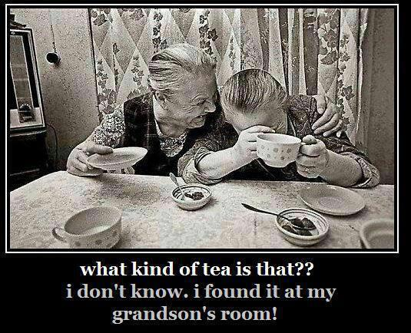
Residents have the same right to drink alcohol as you do.
Notes:
Please honor the resident’s choice, even if you don’t agree with their decision.

Slide 13

Framework for balancing all the pieces
Obtaining a complete life history
Systematic, Accurate Evaluations/Assessments
Individualized, Person Centered Service Plans
Mechanisms for Promoting Choice and Informing about Risk
System for Monitoring
Evaluating Outcomes
Managing Expectations
Measuring Satisfaction
Communication, Communication
Notes:
But when all is said and done we are in a business. We are functionally optimal when we achieve a mission - provide quality outcomes for our customers - and when we make our margins - provide desired results for owners and share holders. When these are out of balance we are often in trouble - either poor quality or poor financial performance. And candidly neither is acceptable.
There are some basic tools that are crucial to balancing margin and decision. Systematic accurate assessments are central both to determining price and creating an individualized plan. Implementing a plan that captures what residents expect, need, and want is the key to delivering quality services and care. And since the power structure in assisted living is uneven, efforts to preserve decision-making and control of their lives is central to creating satisfied consumers. However, having satisfied consumers alone is not enough. We must also make sure we can identify needs, respond appropriately to them, and evaluate the results of our efforts. Further, we have to have the capacity to examine trends that may signal problems with the balance of margin and mission.

Slide 14
Communication is Key
Establishing mutual expectations
Talk about it!
Marketing material
Disclosure and admission documents
Community rules, guideline, codes of conduct
Strategies
Review P&P’s
Translate policies into marketing, disclosure and admission documents
Review preprinted physician orders
Be specific in resident handbooks
Notes:
Review preprinted physician orders

Slide 15
“It pays to boil down your strategy down to one simple promise, then go whole hog in delivering that promise. “ David Ogilvy
We are here to help a person have a life, their life,
in a setting where we :
  are alert to risks,
  make recommendations to help them stay well, and
  take action based on plans they help us develop.

Slide 16

Meet Mr. John Johnson “JJ”
Retired dentist, age 85
Married to the love of his life for 60 years
Travelled the world together
Widowed one year ago
Kids live out of area
Plays poker with “good ole boys” and enjoys beer & wine
JJ is very healthy, walks daily, alert and oriented,
JJ has moderately high BP controlled by medication and has severe allergies in spring and summer.

Slide 17
Fiction/Fact/Action
Fiction: In order for a resident to drink alcohol, they must have a doctor’s order.
Fact is: Resident’s do not need a doctor’s order for them to drink alcohol.
Action/Consideration: Facility needs to assess and care plan regarding JJ’s alcohol use.

Slide 18
Evaluation & Assessment
Notes:
Antihistamines. Drugs such as diphenhydramine (Benadryl and others) are available without prescription to treat allergic symptoms and insomnia. Alcohol may intensify the sedation caused by some antihistamines (15). These drugs may cause excessive dizziness and sedation in older persons; the effects of combining alcohol and antihistamines may therefore be especially significant in this population (19).

Slide 19
What is important to know
Initial inquiry and evaluations should address lifestyle and alcohol preferences, history.
NIAAA recommends alcohol consumption for adults 65+:
    1 standard drink/day or
    7 standard drinks per week
    not to exceed more than 3 drinks on one occasion.
Risks
  Falls
  Drug:Alcohol Interactions
  Depression
  High Blood Pressure
  Behaviors
Benefits
  Enjoyment Quality of Life
  Can Stimulate Appetite
  Support Lifestyle (PCC)
Notes:
While as many as 60% of older persons abstain from alcohol, driving problems are the largest category of substance use problems in older adults.
National Institute of Alcohol Abuse and Alcoholism

Slide 20
Assessment & Service Planning
Assessment, Service Planning and Monitoring are core functions of successful resident services and satisfied customers
Systems need to be fine tuned to assure evaluations, assessment and service plans are comprehensive and current.
Create and review them as an interdisciplinary team.
Easily understood by all

Slide 21
Successful, Person Centered Operations
START with
Asking what does the resident want?
Assess /Evaluate-
Implement that Plan & Monitor
Never jump to an answer .
What do staff need to monitor ?
Accountability –
Quality improvement tools to assure systems work.
Train and inservice staff (routinely)
Document your process and actions.
Action Plan –
Create a CP/SP to support the residents preferences, choices,
Apply Critical Thinking and Root Cause Analysis:
Risk:Action Ratio
The higher the risk the more timely and creative you must be
What is the need? Why? Who has information?
Lifestyle, drinking patterns, diagnosis, medications, depression, other
Put high risk residents on high alert monitoring systems
Carry out the services/plan
Notes:
Ask –
What does the resident want?
Assess -
Never jump to an answer without this step. (RCA)
Be alert –
What will we proactively monitor? What are the high risk issues?
Train staff to observe & report. Monitoring. Predict with known information (crystal ball).
Alternatives /Interventions
The higher the risk the more timely and creative you must be with offering options/interventionsAsk -Again and again
What does this resident want
How complex
Why is it happening
Who has information
What is needed
Action Plan – Do it now. Don’t wait and see.
Accountability – use quality improvement tools to assure systems work.
Use training to assure service is delivered.
Document your process and actions.

Slide 22

Get the Picture ! Get the Plan !
Resident
Evaluation
Service Plan
Preferences
Health Issues Medication
Capabilities
Risk Factors
Lifestyle
Life Patterns

Slide 23
Avoidable event/decline in health status:
Avoidable means the community failed:
To recognize risk factors and/or changes in the resident’s condition
And
To take reasonable measures to assist the resident in obtaining needed services.

Slide 24
Care Planning/Monitoring

Slide 25
Sample Care Plan for JJ
Resident Need | Reason for service | When and how often will service be provided | How will it be provided | Who will provide the service
JJ enjoys poker game with friends. He serves Coors Light & Ruffles | Life long life enrichment activity | Tues each week at 6 pm after dinner in game room. | JJ organizes the game with his friends. He needs staff to help him bring beer & chips to game room. | Staff will assist guests to game room and bring beer and chips from JJ‘s room.
On Tue poker nights JJ needs his allergy medication held. | Avoid Interaction with beer JJ enjoys at his poker games. He | One time week. Tuesday | CMA will review follow MAR | Licensed staff will review MAR and physician order monthly to assure documentation supports holding the medication.
WHAT | ELSE | SHOULD | BE ON HIS | PLAN?

Slide 26
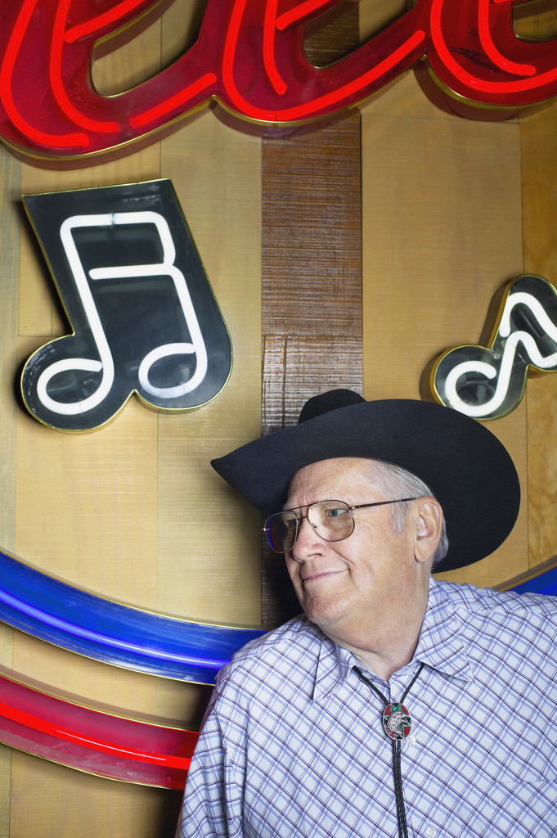
Meet Mike Jones
74 year old retired cattle rancher.
A veteran of the Vietnam War.
Divorcee from two marriages.
Likes to drink Jack Daniels to excess.
Mike often falls after he’s been drinking.
Notes:
Scenario 2:
Mike likes to be the life of the party where ever he is, which means if there isn’t a party going, he will have his own. Mike would often leave the assisted living, walk to the local liquor store, purchase a fifth of Jack Daniels, bring it back to his room and proceed to drink most of the bottle, resulting in multiple falls and behavioral issues. A move-out notice was issued.

Slide 27
Mike’s Care Plan Failed
“Don’t drink to intoxication” “Press call light when need assistance to keep from falling.”
Mike continued to drink excessively and community issued move-out notice.

Slide 28
Fiction/Fact/Action
Fiction: You must issue a move-out notice to a resident who gets drunk and has falls because the resident is a danger to self.
Fact is: Drunkenness is not a valid reason to issue a move-out notice.
Action/Consideration: The facility needs to evaluate the issues and look at root cause analysis

Slide 29
Is a Move-out Notice Appropriate?
There are two types of move-out notices for Residential and Assisted Living Facilities –
30 Day Move-Out Notice
  This is the default notice
Less than 30 Day Move-Out Notice
  Can only be issued for one of two reasons:
  Resident left the facility to receive urgent medical or psychiatric care and facility can no longer meeting needs, or
  Resident or other residents health and safety is in jeopardy and undue delay increases the risk.

Slide 30
Move-out Requirements:
What interventions have been done after discovery of the situation to try and resolve the issue?
Can facility issue Move-Out Notice
Mike’s Drinking
Notes:
Facility hadn’t tried alternatives prior to issuing MON. Can’t issue MON.

Slide 31
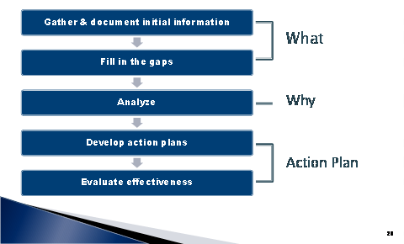
Root Cause Analysis Steps

Slide 32
Evaluate Situation
What does Mike want?
Assess
Implement/Monitor
Accountability
Mike’s Action Plan
Interventions and Risks
Notes:
Ask –
What does Mike want?
Assess -
Never jump to an answer without this step. (RCA)
Be alert –
What will we proactively monitor? What are the high risk issues?
Train staff to observe & report. Monitoring. Predict with known information (crystal ball).
Alternatives /Interventions
The higher the risk the more timely and creative you must be with offering options/interventions
Ask -Again and again
What does this resident want
How complex
Why is it happening
Who has information
What is needed
Action Plan – Do it now. Don’t wait and see.
Accountability – use quality improvement tools to assure systems work.
Use training to assure service is delivered.
Document your process and actions.

Slide 33
Mike’s New Care Plan
Resolution to this situation:
Resident to have up to two shots of Jack Daniels per day, in the late afternoon, provided by a Med Aide.
The med cart was draped and set up to resemble a portable bar. On it were a very nice glass (with ice), shot glass and bottle of Jack Daniels. The MA would come to the resident’s room and pour one shot, remove the drape and wipe down the top of the med cart/bar with a wet towel and chat the resident up a bit. If the resident requested a second shot, the same routine was followed by the MA. This was charted in the MAR for tracking purposes and for updating the FNP.
It was reported on 2/20/13, the intervention continues to be successful and usually one shot is satisfactory.
Notes:
The resident still occasionally goes out and comes back with a bottle, which is intercepted by MA/bartender. When asked if the bottle can be “added to their stock,” s/he is very agreeable. They do remind the resident that a relative keeps them (the facility) well stocked with Jack Daniels, "but it never hurts to have extra on hand." S/He agrees you cannot have enough whiskey on hand and is glad to help the bar out with his/her most recent purchase.
The incidents of drinking more than two shots per day have not resumed.

Slide 34

Meet Rose Wilson
Married her high school sweetheart right after high school and was married for 35 years.
Husband died in a car accident.
Has 3 children, 14 grandchildren, and 1 great-grandchild on the way.
After death of her husband, she completed nursing school and is a retired RN.
Rose lives in an assisted living facility.
History of depression
Notes:
Rose is very sure of what is good for her, and what isn’t – especially since she is an RN. Iitially Rose had a glass of wine. That changed a few months when Rose started hitting staff. Situation has escalated to the point now where Rose has started yelling at staff in the dining room. Some residents have started Last night Rose raised her fist at another resident who didn’t get out of her way in the elevator quick enough.
Issue: R been verbally abusive to other residents.

Slide 35
Risk : Responsibility ~ The Escalating Line
High Risk
Moderate Risk
Basic Need | ←Staff Action in Response to Need→
 | Offer Routine Planning | Encourage More Problem Solving | Motivate Explaining Consequences Additional Resources

Slide 36
Root Cause Analysis Steps

Slide 37
Evaluate Situation
What does Rose want?
Assess
Monitor
Accountability
Rose’s Action Plan
Interventions and Risks
Notes:
Ask –
What does Mike want?
Assess -
Never jump to an answer without this step. (RCA)
Be alert –
What will we proactively monitor? What are the high risk issues?
Train staff to observe & report. Monitoring. Predict with known information (crystal ball).
Alternatives /Interventions
The higher the risk the more timely and creative you must be with offering options/interventions
Ask -Again and again
What does this resident want
How complex
Why is it happening
Who has information
What is needed
Action Plan – Do it now. Don’t wait and see.
Accountability – use quality improvement tools to assure systems work.
Use training to assure service is delivered.
Document your process and actions.
Resolution to this situation:
After the MON was issued alternate solutions were considered. Before the move-out date arrived, the facility brainstormed with a FNP and came up with a plan:
The FNP ordered the resident to have up to two shots of Jack Daniels per day, in the late afternoon, provided by a Med Aide. The med cart was draped and set up to resemble a portable bar. On it were a very nice glass (with ice), shot glass and bottle of Jack Daniels. The MA would come to the resident’s room and pour one shot, remove the drape and wipe down the top of the med cart/bar with a wet towel and chat the resident up a bit. If the resident requested a second shot, the same routine was followed by the MA. This was charted in the MAR for tracking purposes and for updating the FNP.
It was reported on 2/20/13, the intervention continues to be successful and usually one shot is satisfactory. The resident still occasionally goes out and comes back with a bottle, which is intercepted by MA/bartender. When asked if the bottle can be “added to their stock,” s/he is very agreeable. They do remind the resident that a relative keeps them (the facility) well stocked with Jack Daniels, "but it never hurts to have extra on hand." S/He agrees you cannot have enough whiskey on hand and is glad to help the bar out with his/her most recent purchase.
The incidents of drinking more than two shots per day have not resumed.

Slide 38
Managed Risk 411-054-0036
Used when
Harm is likely
Harm is substantial
Parties disagree about service plan
What it’s not
A contract
A waiver of liability
A legal defense tool
It is not a tool to get the provider off the hook!

Slide 39
Negotiated/Managed Risk Agreements
Social Ethics
Formal Process
Communication
Clarification
Resident centered
Consensus
Explain cause/s of concern
Describe probable negative outcome
Describe what resident wants
List alternatives to minimize risk
Describe what facility and others will do
Describe final agreement

Slide 40
Valid Managed Risk Agreement
Residents preferences take precedence over family members
Invalid if resident cannot understand consequences
Reviewed at least quarterly. More often as situation dictates.
Notes:
Final straw – Rose raise her fist to another resident when she didn’t get out of her way fast enough.

Slide 41
Move-out Requirements:
What interventions have been done after discovery of the situation to try and resolve the issue?
Rose’s drinking and aggression
Notes:
Ask –
What does Mike want?
Assess -
Never jump to an answer without this step. (RCA)
Be alert –
What will we proactively monitor? What are the high risk issues?
Train staff to observe & report. Monitoring. Predict with known information (crystal ball).
Alternatives /Interventions
The higher the risk the more timely and creative you must be with offering options/interventions
Ask -Again and again
What does this resident want
How complex
Why is it happening
Who has information
What is needed
Action Plan – Do it now. Don’t wait and see.
Accountability – use quality improvement tools to assure systems work.
Use training to assure service is delivered.
Document your process and actions.
Resolution to this situation:
After the MON was issued alternate solutions were considered. Before the move-out date arrived, the facility brainstormed with a FNP and came up with a plan:
The FNP ordered the resident to have up to two shots of Jack Daniels per day, in the late afternoon, provided by a Med Aide. The med cart was draped and set up to resemble a portable bar. On it were a very nice glass (with ice), shot glass and bottle of Jack Daniels. The MA would come to the resident’s room and pour one shot, remove the drape and wipe down the top of the med cart/bar with a wet towel and chat the resident up a bit. If the resident requested a second shot, the same routine was followed by the MA. This was charted in the MAR for tracking purposes and for updating the FNP.
It was reported on 2/20/13, the intervention continues to be successful and usually one shot is satisfactory. The resident still occasionally goes out and comes back with a bottle, which is intercepted by MA/bartender. When asked if the bottle can be “added to their stock,” s/he is very agreeable. They do remind the resident that a relative keeps them (the facility) well stocked with Jack Daniels, "but it never hurts to have extra on hand." S/He agrees you cannot have enough whiskey on hand and is glad to help the bar out with his/her most recent purchase.
The incidents of drinking more than two shots per day have not resumed.

Slide 42
Interventions attempted:
Discussed situation with resident/family/Dr.
Additional training for staff
Care plan/Service plan modification
Managed Risk
Notes:
Also checked R’s medications to see if needed to change those.

Slide 43
Move-out Requirements:
What interventions have been done after discovery of the situation to try and resolve the issue?
Rose’s drinking and aggression
Documentation: have all interventions been documented?
Issue Move-Out Notice

Slide 44
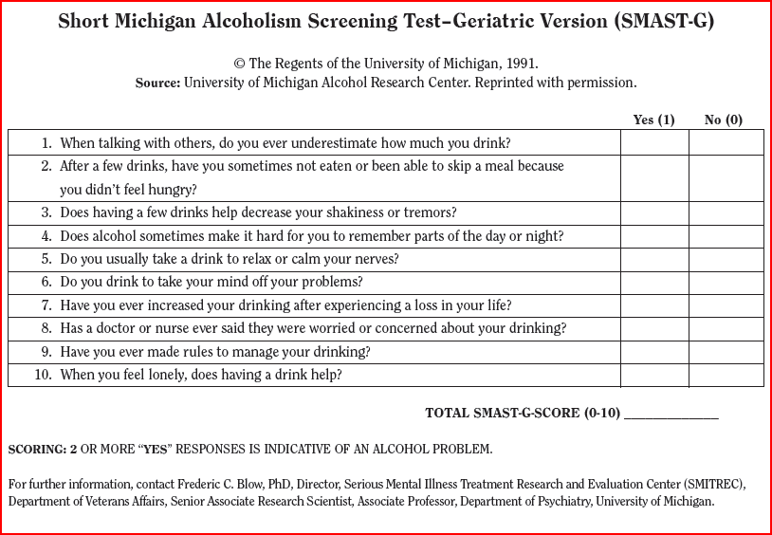

Slide 45
Alcohol use in a nutshell:
Resident’s right to drink.
Facility’s responsibility to provide a safe environment.
Notes:
Balancing Rights, risk and responsibility.

Slide 46
Take aways…..
Yes, older adult drink ~ Person Centered Care
Understand the “why” of the behavior or need
What are three other specific ideas/tools you heard today?
  QUESTIONS? THANK YOU!!

